Slide 1
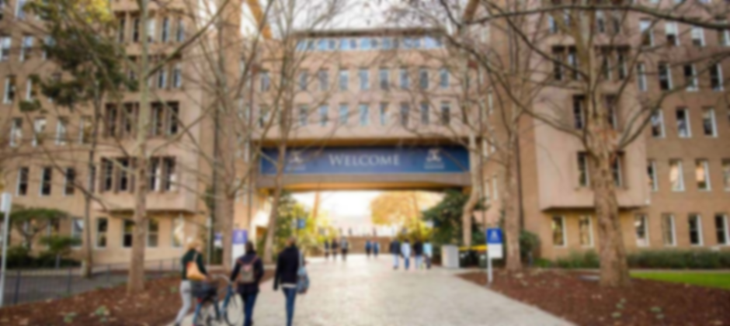

MAST90106 Data Science Project Part I (Group1)
May 2022

Slide 2

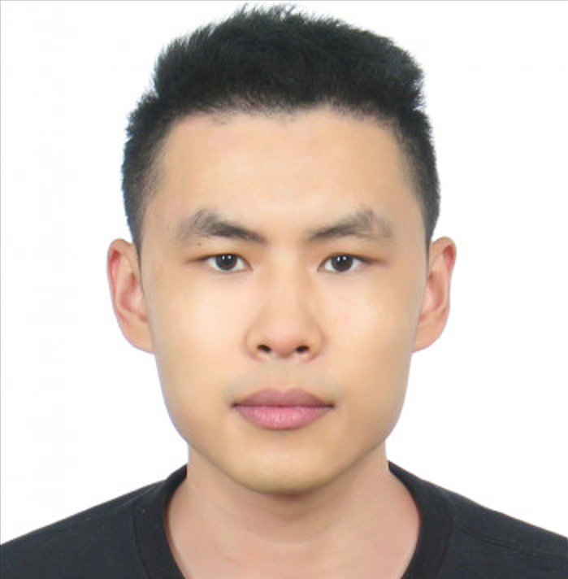

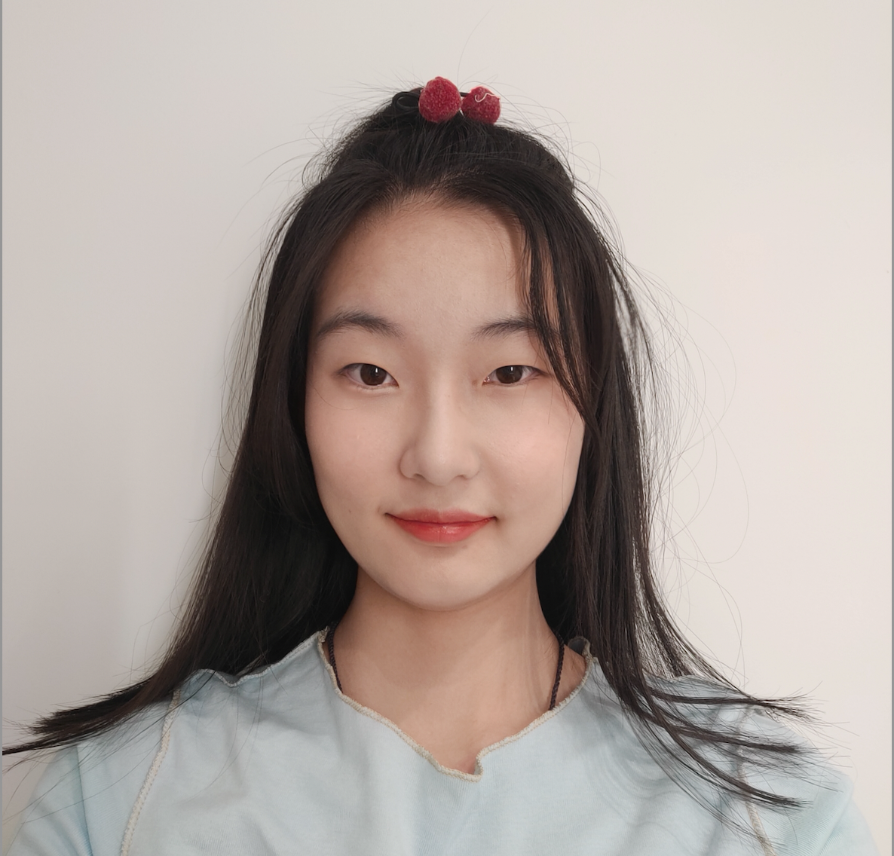
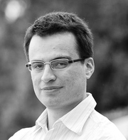
The team has 4 core members: Abhishek, Jiajie, Jerry and Yihan. Andres is our supervisor
Abhishek Yadav
Jiajie Xu
Jerry Chen
Yihan Wang
Dr. Andres Munoz (Supervisor)
PIC
PIC
Skills:
Machine Learning model building
Data Analysis
Statistical Modelling
Contribution:
Data extraction, cleaning, and preparation for cluster analysis
Cluster analysis on time-series data and insights
Documentation of the above
Reviewed related works
Skills:
Comprehensive data science model judgment
Algorithm analysis and evaluation
Contribution:
Preliminary data science model selection
Related-works collection
Preliminary task allocation with Gantt diagram next semester
GitHub management
ROLE
ROLE
Skills:
Client liaison
Data Analysis
Statistical Modelling
Contribution:
Co-ordinated meetings
Reviewed related works
Analysed data and created ER diagram
Time-series preliminary modelling using dynamic time warping
Skills:
Statistical Modelling
Data Analysis
Contribution:
Reviewed previous work related to the problem
Model selection
Report writing
Data extraction and cleaning
Skills:
Optimisation Technologies
Integrated Methodologies and Applications
Contribution:
Supervise in meetings
Provide recommendations on team working
Provide guidance on technical topics
Notes:
My name is… My main role on the team so far has been…

Slide 3

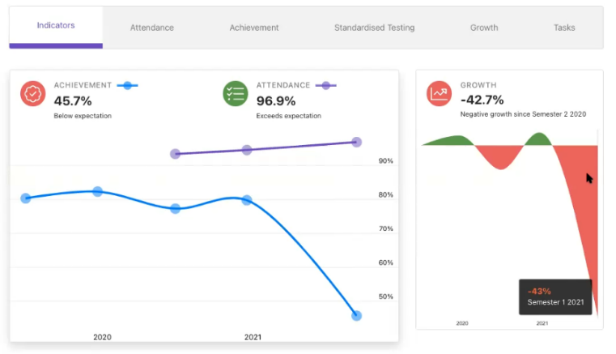

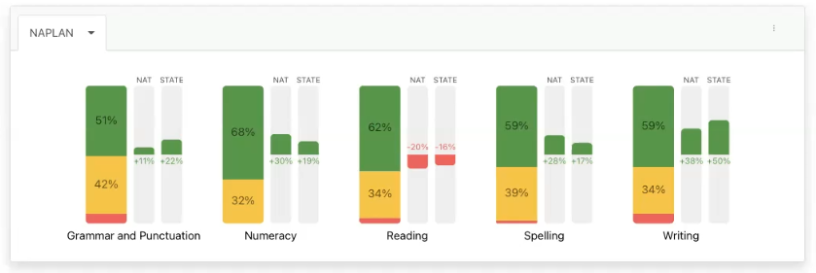


Intellischool partners with global education data platforms to leverage their data and provide unique insights on students and teachers
A cloud platform that leverages K-12 school data to serve automated analytics, indicators and performance insights.
Intellischool’s LMS Data Platform Partnerships
+
+
+
Notes:
Our project is with Intellischool, a cloud analytics start-up that partners with the world’s largest education learning platforms, leverages their data to provide insights on various aspects of schooling from performance, to behaviour in the classroom.
The company has two main types of products, Integration-as-a-service and analytics product.
Our project will focus on the second type -- descriptive analytics.

Slide 4





Basic Setups
Children Check
Working Tools
4 Windows remote machines
Azure Data platform
PostgreSQL
Jupyter notebook
Fortnightly Client Meetings
Teams​
Slack
Notes:
For security reason for accessing the data for k-12 students, all of the members did the children check. We also use four Window10 remote machines to access the data using Azure Data platform. The dataset are stores in Postgre SQL. And we implement our code in Jupyter notebook using python.
Using Teams to communicate with clients and a 1hr zoom session fortnighly. Also, share our progress with Andres, our academic supervisor using Slack and also the zoom session fortnightly.

Slide 5
Intellischool’s two main project problem statements both involve finding ways to process the large and disparate amount of school data in order to surface explanation and actionable insight on students and teachers
1
CAN WE BETTER UNDERSTAND STUDENTS?
What attendance, behaviour, aptitude, performance clusters exist that capture student characteristics and personas such that they can be used for prescriptive actionability
2
CAN WE PREDICT PERFORMANCE?
What factors and features exist in the data that best contribute and predict student grades such that we can use a model to report on and uplift performance
Notes:
The two problems they’ve proposed to us are, ways to use data science to 1) better understand students, and 2) predict student performance.
Our first task is to find the clusters of students with similar characteristics, and determine the number of clusters and what are they represented.
And the second task is to predicting the grades based on the academic performance previously.

Slide 6
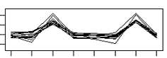
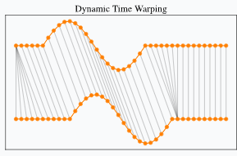
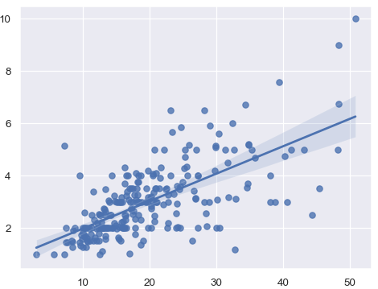
We plan to investigate three different methods to tackle the problem statements, primarily through reducing the size and complexity of data through clustering and dimension reduction
Problem Statement
Suggested Solution
Example
1
UNDERSTANDING STUDENTS
Clustering within Timestep
For one time period, extract student attribute data e.g. attendance, grades…etc
Determine student clusters by comparing with other students and analyse clusters for persona descriptors
Repeat for multiple periods and track student cluster changes over time
Student Performance Analysis with Using Statistical and Cluster Studies, 2019,
Clustering across Timesteps
Extract student attribute data over time e.g. attendance, grades…etc
Merge attributes together into multidimensional trend line for each student
Cluster students by trend comparative techniques e.g. Dynamic Time Warping
Analyse clusters for persona descriptors
An efficient implementation of anytime k-medoids clustering for time series under dynamic time warping, 2016
2
PREDICTING PERFORMANCE
Prediction Modelling
Using PCA for dimension reduction/feature selection
Predict the academic grades based on the NN model (e.g.CDF-NN)
Map-Reduce framework based cluster architecture for academic student’s performance prediction using cumulative dragonfly based neural network. (2019)
Notes:
To better understand the students, our literature review surfaced various ways to tackle this using timeseries clustering which we’ve narrowed down to two promising methods which Abhishek will talk more on later.
For the problem of predicting performance, there has been an abundance of literature but the key challenge for us is working with our specific datasets. As we’ve found, our data needs a lot of cleansing.

Slide 7
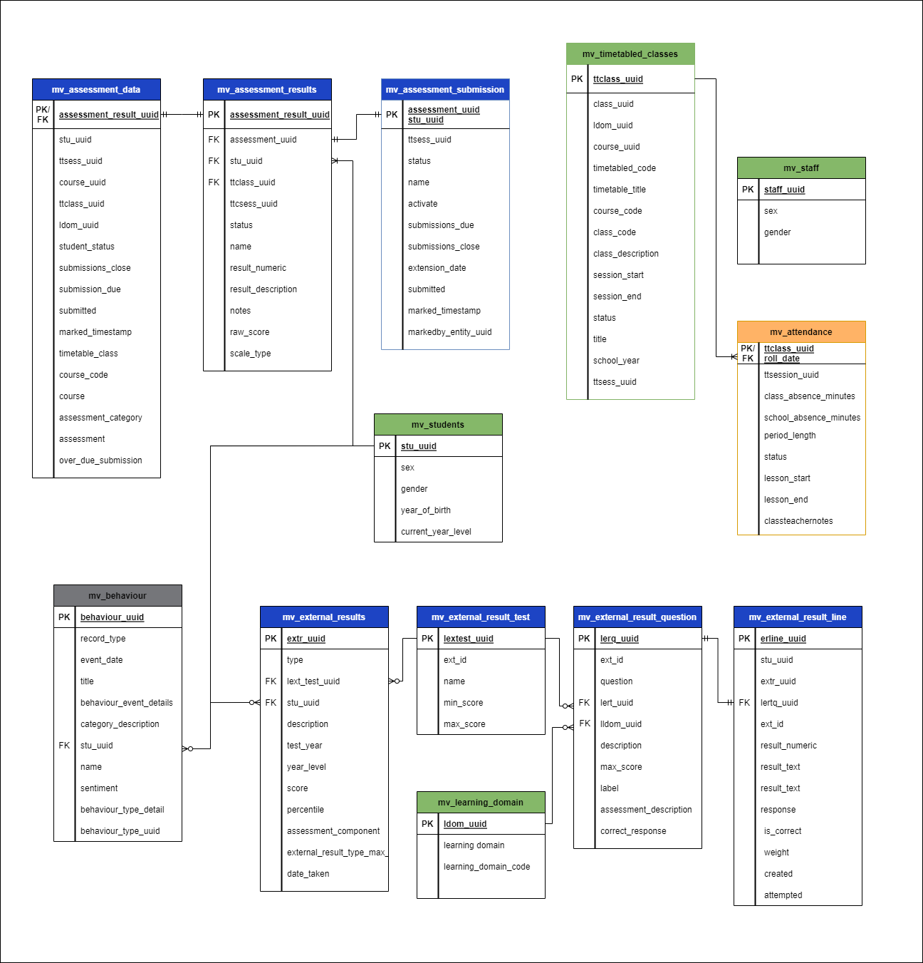
Assessment and attendance data are high volume relational tables that require multiple joins to map students with their performance over time, across many class subjects
Master Data
Student
Teachers
Classes
Attendance
Absence length
Behaviour
Incident Events
Assessment
Standardised Results
NAPLAN/ACER/ICAS
Question & Answers
Scores/Percentiles
Internal Results
Quizzes/Homework
Submission/due date
Teacher notes
Detailed E-R Diagram of Intellischool subset data created by for MAST90106 project
Notes:
Data on the students

Slide 8
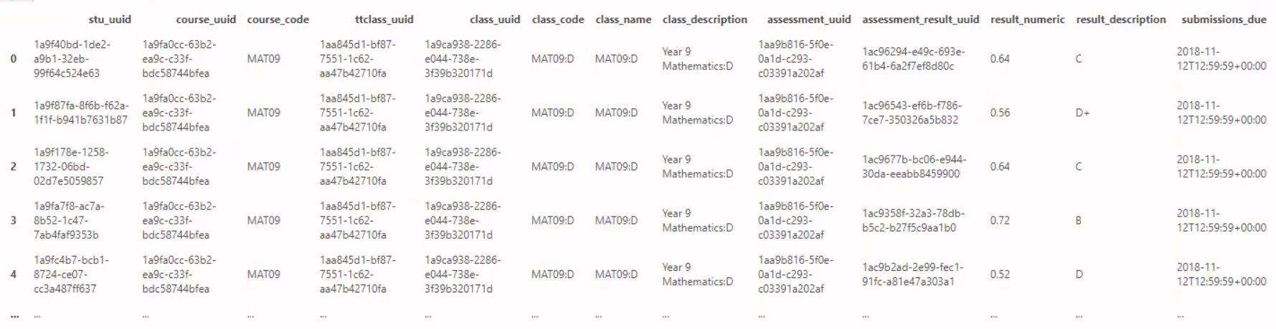
Proof of Concept: Cluster Analysis
The aim is to capture the performance pattern of various students over time
Data sample considered: 'MAT09' semester 1 assessment scores of year 9 students of 2018 batch of a particular class from a particular school

Slide 9
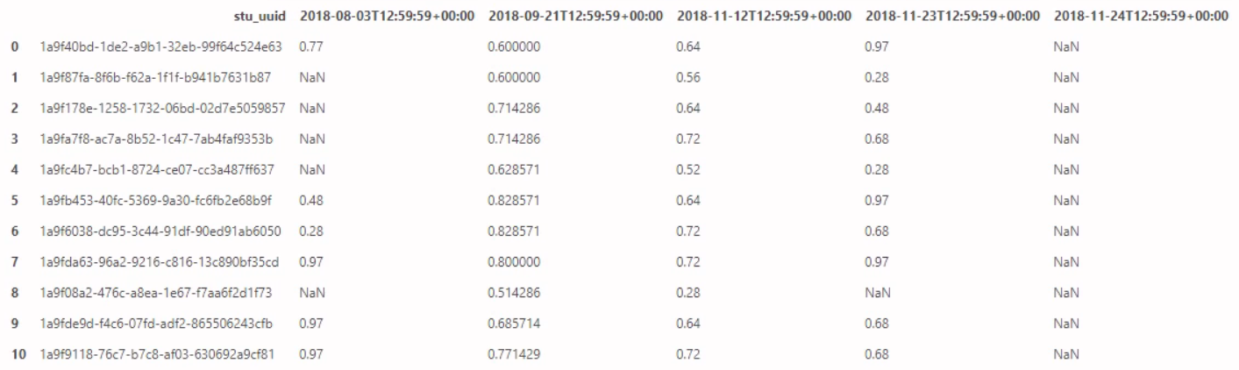
Proof of Concept: Cluster Analysis
Data Preparation

Slide 10
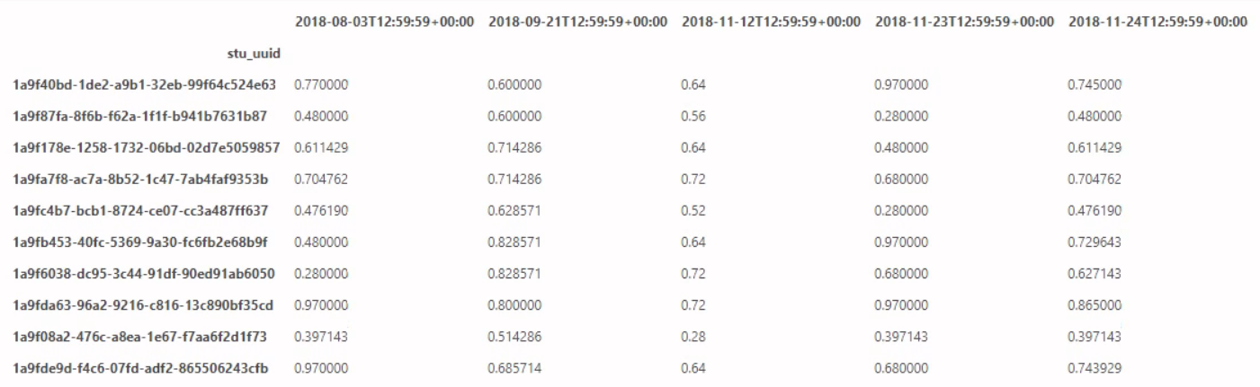
Proof of Concept: Cluster Analysis
Imputing Missing Values

Slide 11
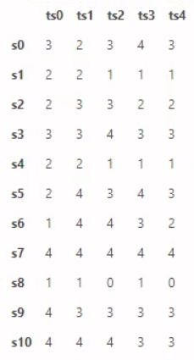
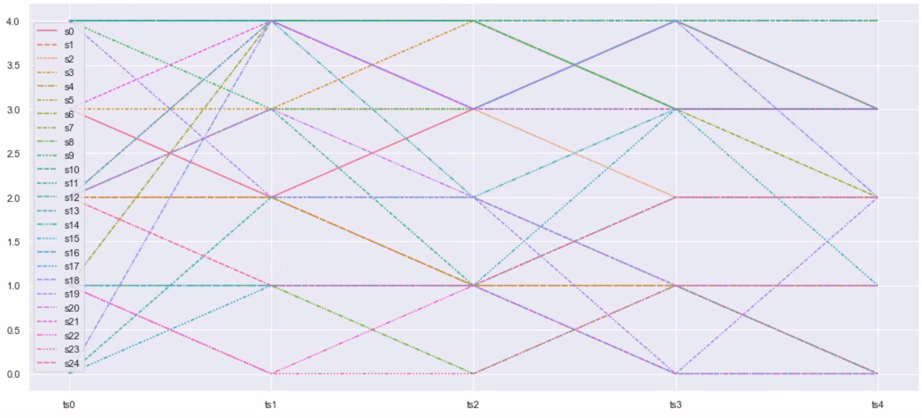
Proof of Concept: Cluster Analysis
Clustering within each time-step
Clusters
Timesteps

Slide 13
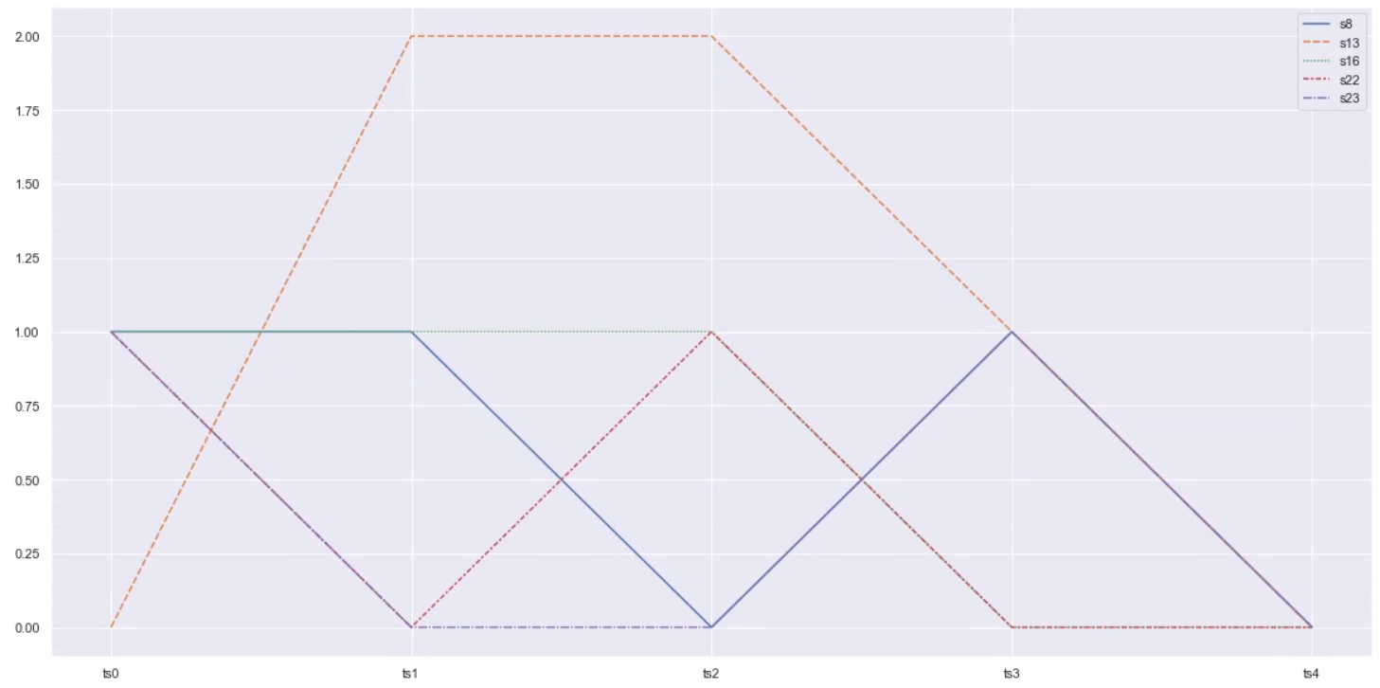
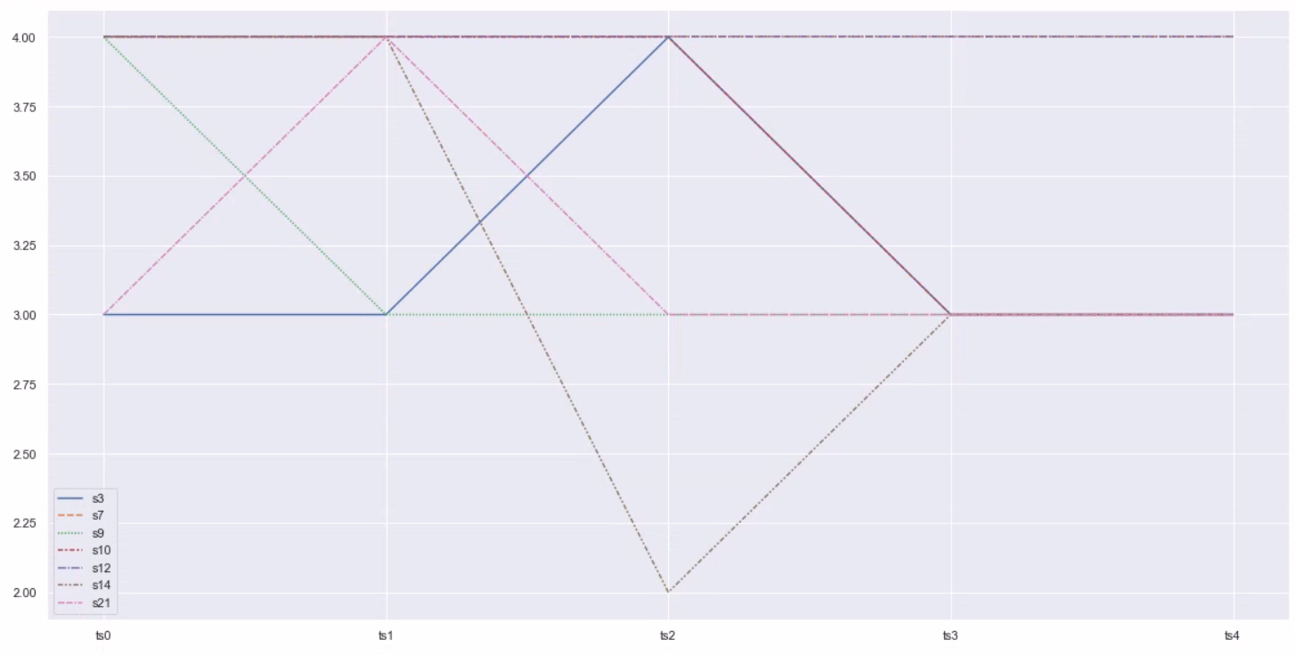
Proof of Concept: Cluster Analysis
Clustering clusters across time-steps (1)
Cluster A
Cluster B
Clusters
Timesteps
Timesteps

Slide 14
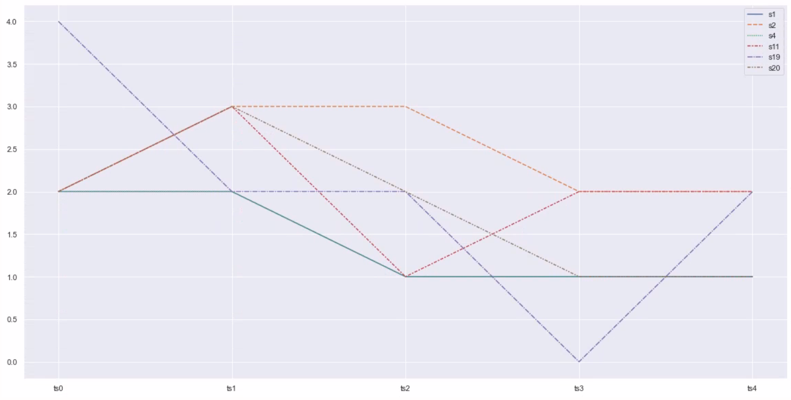
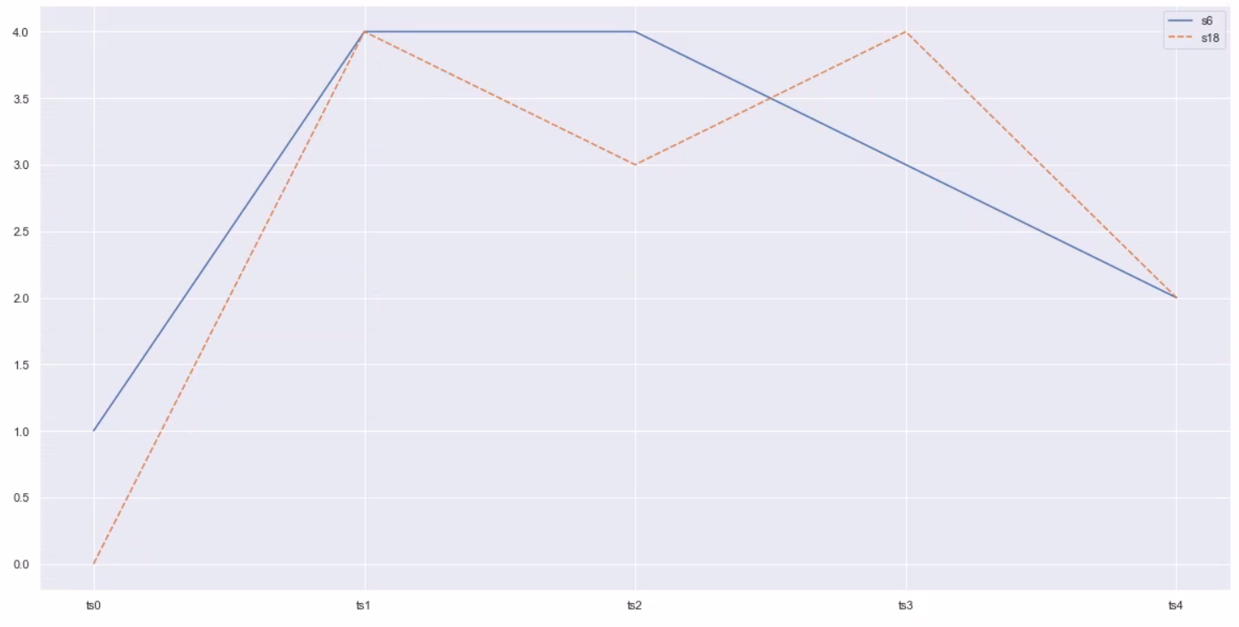
Proof of Concept: Cluster Analysis
Clustering clusters across time-steps (2)
Cluster C
Cluster D
Clusters
Timesteps
Timesteps

Slide 15
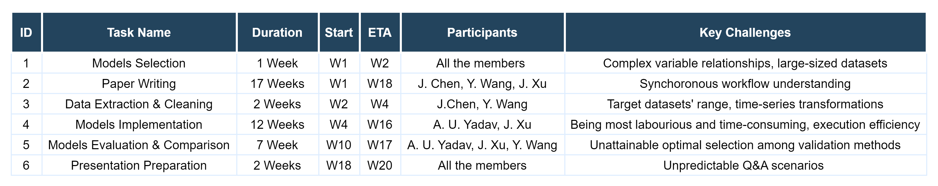
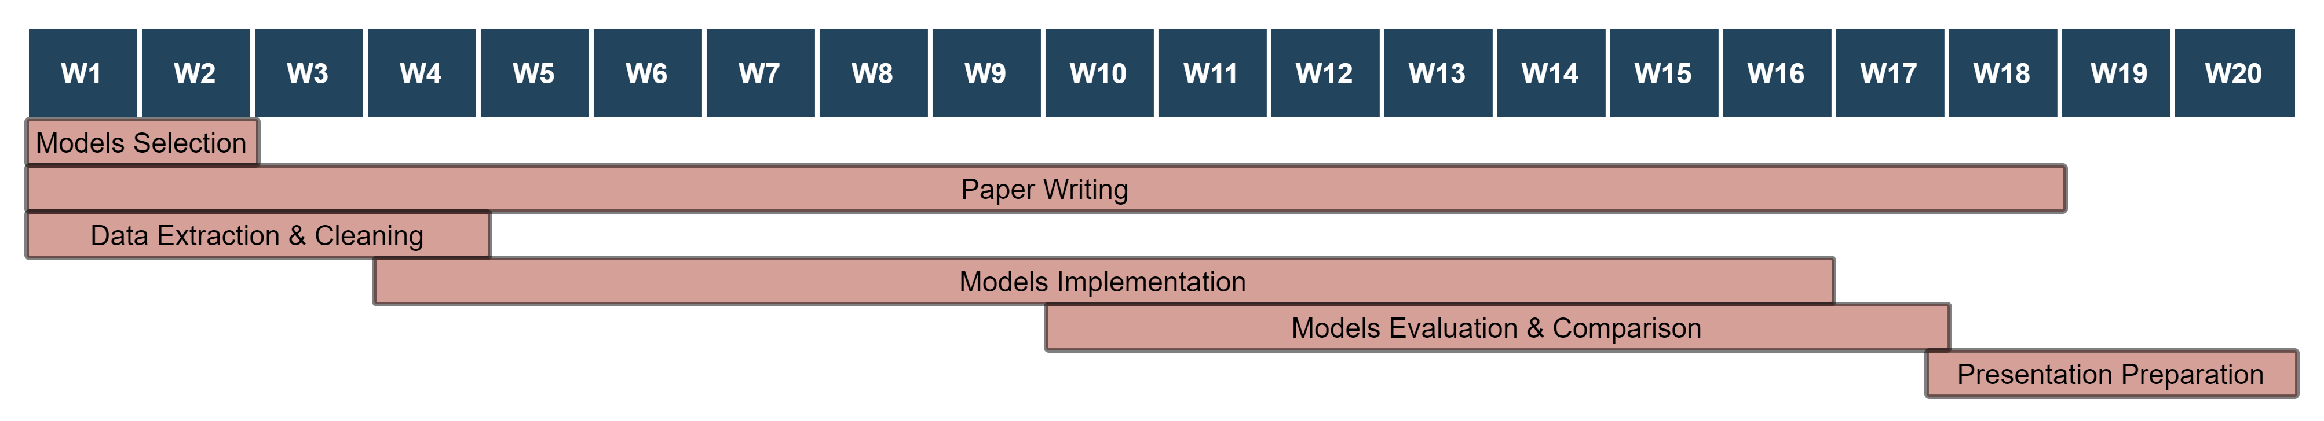
Next Steps
Gantt plan for Semester 2

